Slide 1

Inductance of Three Phase Lines
EE 471 POWER SYSTEM ANALYSIS I
Prof. Dr. Sezai Dinçer

Slide 2

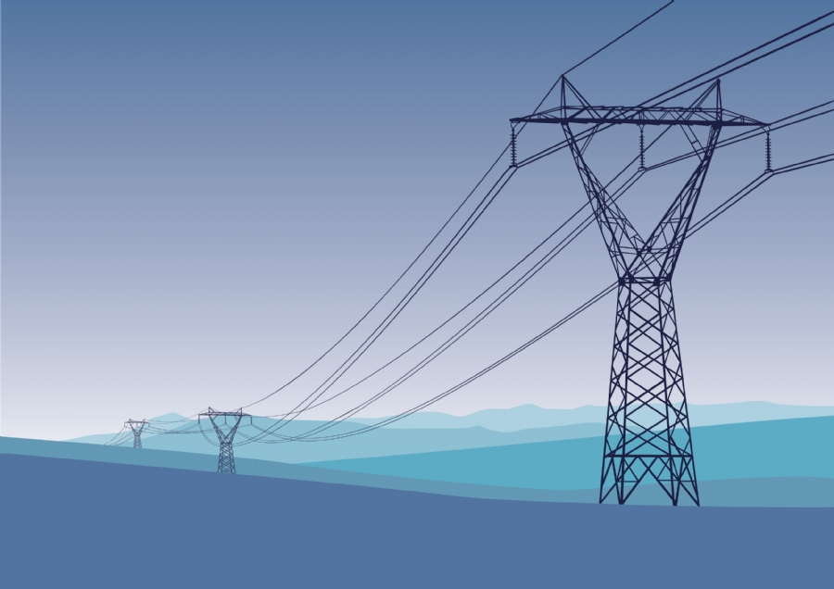
EE 471 POWER SYSTEM ANALYSİS I

Slide 3
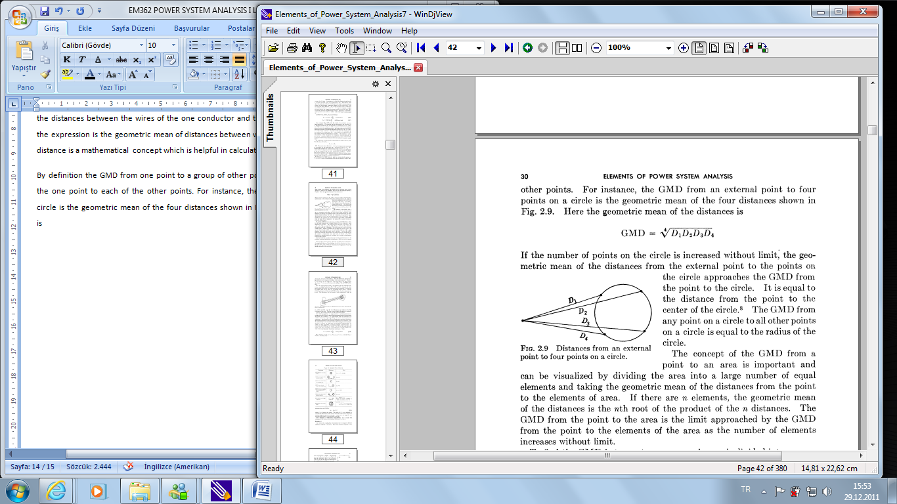
INDUCTANCE CALCULATION AND GEOMETRIC MEAN DISTANCE
1
2
Distances from an external point to four points
P
3
4
By definition the GMD from one point to a group of other points is the geometric mean of the distances from the one point to each of the other points. For instance, the GMD from an external point to four points on a circle is the geometric mean of the four distances shown in Figure. Here the geometric mean of the distances is

Slide 4

Inductance Calculation
Ds is the equivalent self GMD
Dm is the Geometric Mean Distance

Slide 5
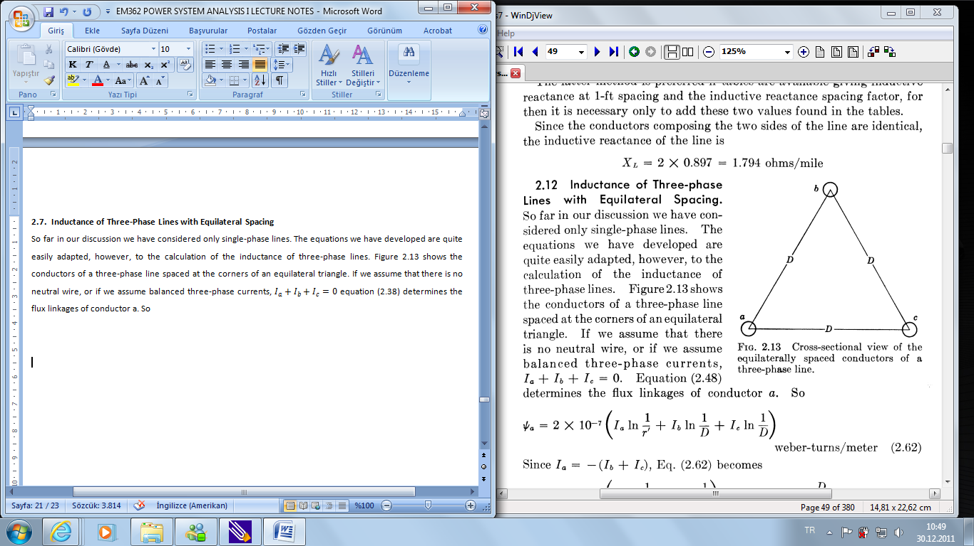

Inductance of Three-Phase Lines with Equilateral Spacing
Flux linkages of conductor a
Since I_{a}=-I_{b}-I_{c}, Eq. becomes
For stranded conductors, D_{s} replaces r’ in the equation. Because of symmetry, the inductances of conductors b and c are the same as the inductance of conductor a
Cross-sectional view of the equilaterally spaced conductors of a three-phase line.

Slide 6
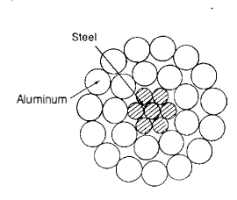
ACSR (aluminium Conductor Steel Reinforced)
7 steel strands provides mechanical strength to carry the line
Self GMD of such conductors are given by the manufacturer.

Slide 7
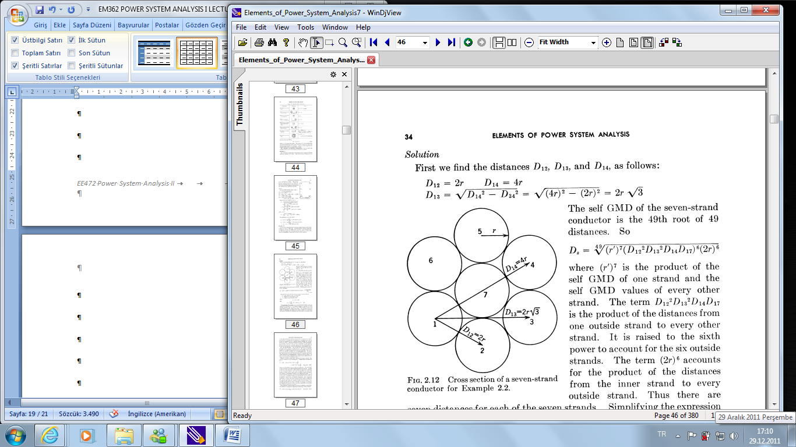

Example :Seven Strand Conductor
A conductor is composed of seven identical strands, each having a radius r as shown in Fig. Find the factor by which r should be multiplied to find the self GMD of the conductor. Also find the factor by which the square root of the area of the conductor in circular mils should be multiplied to obtain the self GMD of the conductor.
Solution:
First we find the distances D₁₂, D₁₃, and D₁₄, as follows:

Slide 8
Calculation of Self GMD for unconventional stranded conductors
GMR(Self GMD)=?

Slide 9
Calculation of Self GMD
GMR=?

Slide 10
Calculation of Self GMD
GMR=?

Slide 11
Inductance of Three-phase Lines with Unsymmetrical Spacing
When the conductors of a three-phase line are not spaced equilaterally, then the flux linkages and inductance of each phase are not the same. A different inductance in each phase results in an unbalanced circuit and in induced voltages in adjacent communication . These undesirable characteristics can be overcome by exchanging the positions of the conductors at regular intervals along the line so that each conductor occupies the original position of every other conductor over an equal distance. Such an exchange of conductor positions is called transposition

Slide 12
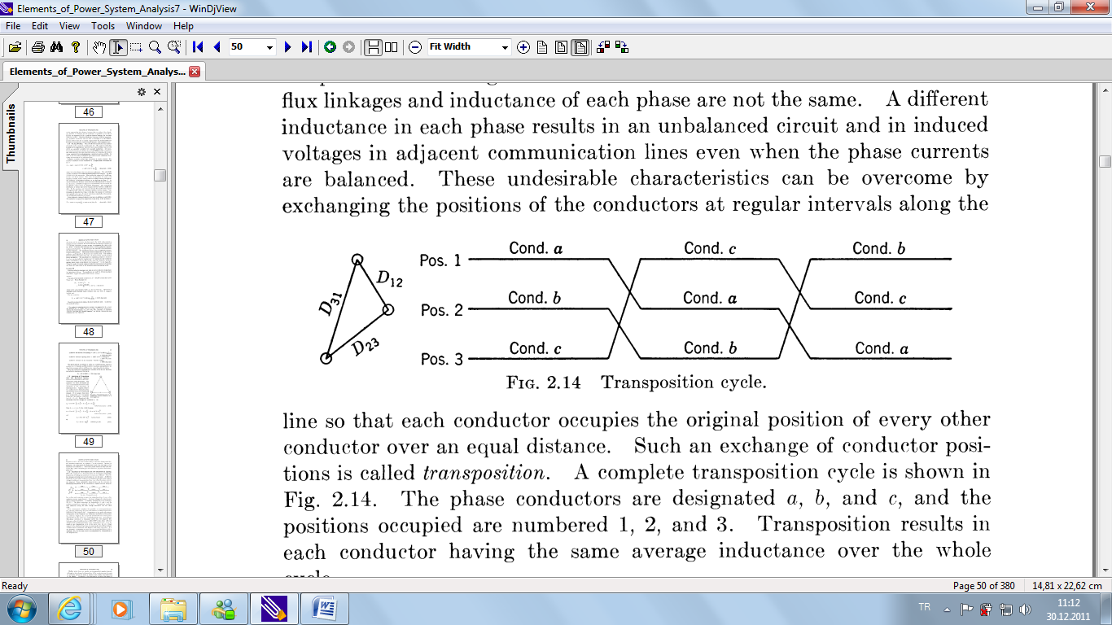
Transposition Cycle

Slide 13
Flux linkages of phase a in position 1

Slide 14
Flux linkages of phase a in position 2

Slide 15
Flux linkages of phase a in position 3

Slide 16


Inductance per phase per meter
The average value of the flux linkages of a is
With the restriction that I_{a}=-(I_{b}+I_{c}),

Slide 17
EXAMPLE
GMR is given by the manufacturer as Ds = 0.0159 m

Slide 18
BUNDELED CONDUCTORS

Slide 19
Calculation of Self GMD (GMR) for bundle conductors

Slide 20
EXAMPLE
Three Phase line with bundled conductor is shown in the figure. Self GMD (GMR) of 26/2 stranded conductor is 0.0114 m
Asume that the line is completely transposed. Calculate the inductance of the line. (f=60 Hz, line length is 200 km))

